Slide 1
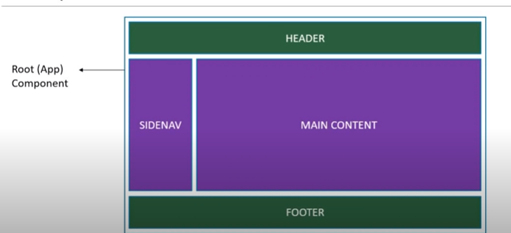
Component

Slide 2
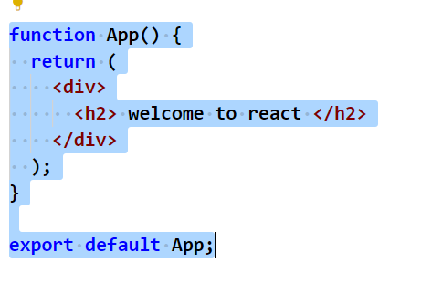
First Modification in project->App.js

Slide 3
create component using new .js file

Slide 4
FunctionalComponent

Slide 5
ClassComponent

Slide 6
Functionalcomponent vs ClassComponent

Slide 7
export default

Slide 8
named export

Slide 9
conditional rendering

Slide 10
if else vs element variable

Slide 11
working with list

Slide 12
using map

